Slide 1


CSE332: Data Abstractions Section 1
Hye In Kim
Winter 2013

Slide 2
Section Agenda
Introduction
Generics
Project 1
Eclipse Tutorial

Slide 3
Introduction - Me
HyeIn (Han) Kim
From Korea
5th year Master’s student
BS in Biology & CSE at UW
Teaching section AA & AB
- Office hour: Thursday 10:00 ~ 11:00, CSE 216
- Email: kainby87@uw.edu

Slide 4
Introduction - You
Name
Year
Home Town
Interesting Fact about yourself
What you did over the break

Slide 5
Generics
What is generics?
- Technique of writing class/Interface without
specifying type of data it uses
- Idea: class/interface can have type parameter
Usually denoted as T or E

Slide 6
Generics
What is generics?
public interface List <E> {
void add(E x);
…
}
public class Bag<E> {
private E item;
public void setItem(E x) { item = x; }
public E getItem( ) { return item; }
}

Slide 7
Generics
Why generics?
- Pre Java 5: Objects
public class Bag {
private Object item;
public void setItem( Object x ) { item = x; }
public Object getItem() { return item; }
}
Bag b = new Bag();
b.setItem( "How about that?" );
String contents = (String) b.getItem();

Slide 8
Generics
Why generics? Type Safe Containers
- Main advantage: compile-time type checking
Bag b = new Bag();
b.setItem( "How about that?" );
double contents = (double) b.getItem();
- Above code will have runtime error
- Generics: Ensure correct type at compile time
No need for cast or Type checking

Slide 9
Generics
More Generics: References
- Generics & Inheritance
- Wild cards
http://www.cs.washington.edu/education/courses/cse332/12sp/section/week1/GenericsAndJUnit.pdf
http://www.cs.washington.edu/education/courses/cse332/12sp/section/week1/Bag.java
http://www.cs.washington.edu/education/courses/cse332/12sp/section/week1/Tuple.java
Textbook 1.4 ~ 1.5

Slide 10
Project 1
Sound Blaster!
- Part A: Due next Wednesday, 11pm
Part B: Due Tuesday Jan 22th, 11pm
- Personal Project: No partners!
Collaboration Policy
http://www.cs.washington.edu/education/courses/cse332/13wi/policies.shtml
Grading Policy
http://www.cs.washington.edu/education/courses/cse332/13wi/grading-policies.shtml
Programming Guidelines
http://www.cs.washington.edu/education/courses/cse332/13wi/programming-guidelines.shtml

Slide 11
Project 1
Part A
- Implement Stack ADT: Stores double
Implement interface DStack
Using Array (ArrayStack)
Using Linked List (ListStack)
Part B
- Implement Stack ADT: Use generic
Implement interface GStack
Using Array (GArrayStack)
Using Linked List (GListStack)

Slide 12
Project 1
Reverse.java
- Handles all music stuff
- No need to edit for part A
- Reverses in.dat file and writes it to out.dat
- Accepts 4 command line parameters
Stack Implementation: array or list
Content type: double or generic
Input file name: ex) in.dat
Output file name: ex) out.dat

Slide 13
Project 1
Sound Exchange (SOX)
- Converts .wav file to .dat file & vice versa
Reverse.java needs .dat file
You need .wav file to play sound
- Installed in lab machine
- Use in command prompt / terminal
ex) sox secret.wav secret.dat

Slide 14
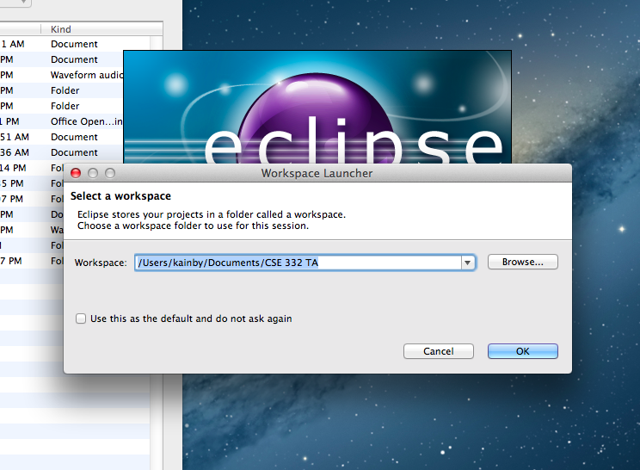
Eclipse Tutorial
Select WorkSpace

Slide 15
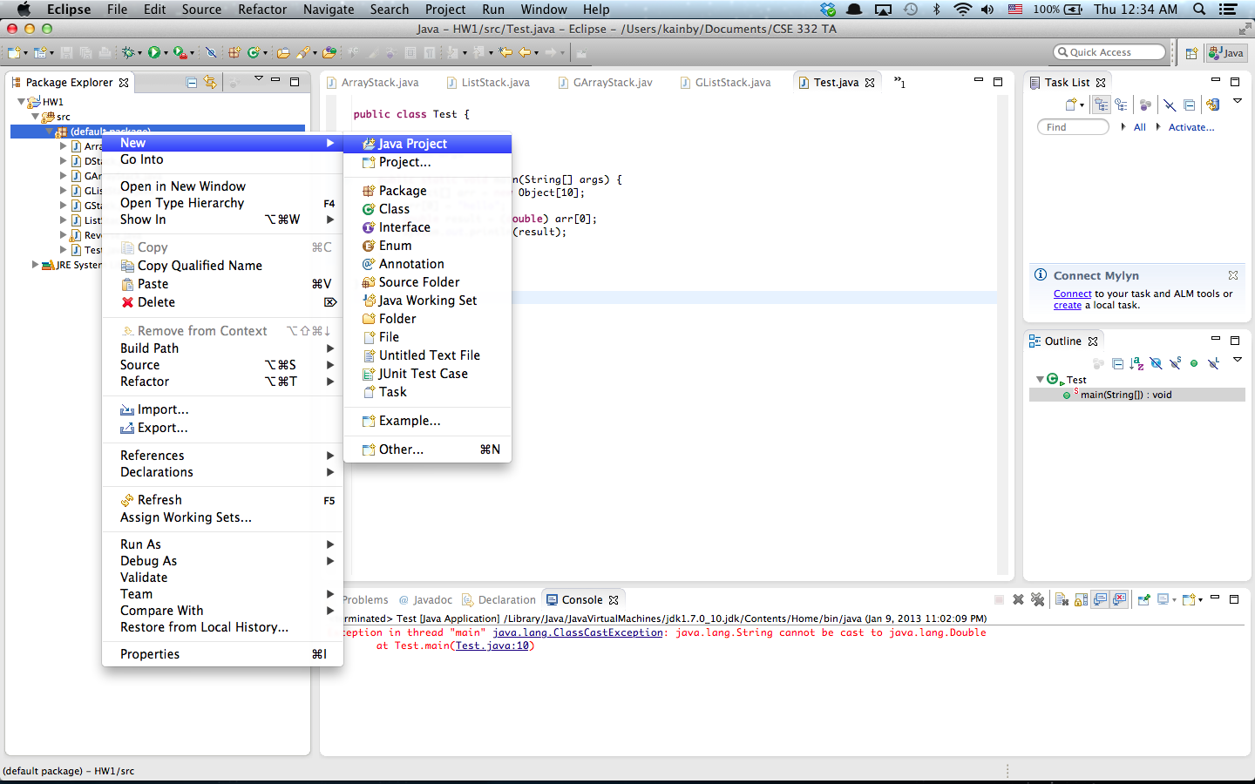
Eclipse Tutorial
Create Project

Slide 16
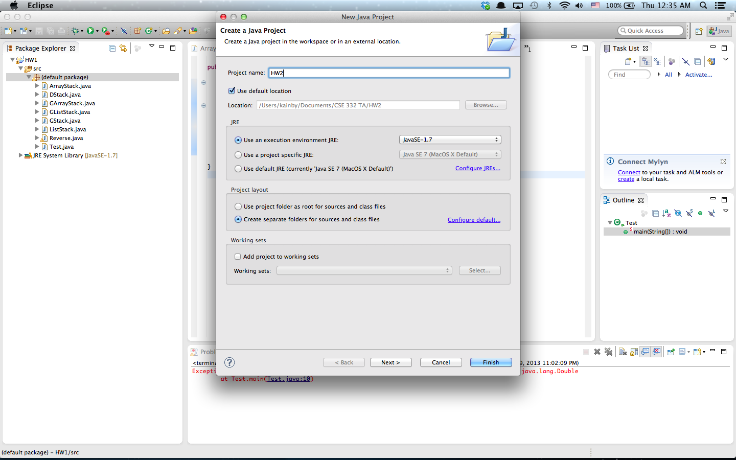
Eclipse Tutorial
Create Project

Slide 17
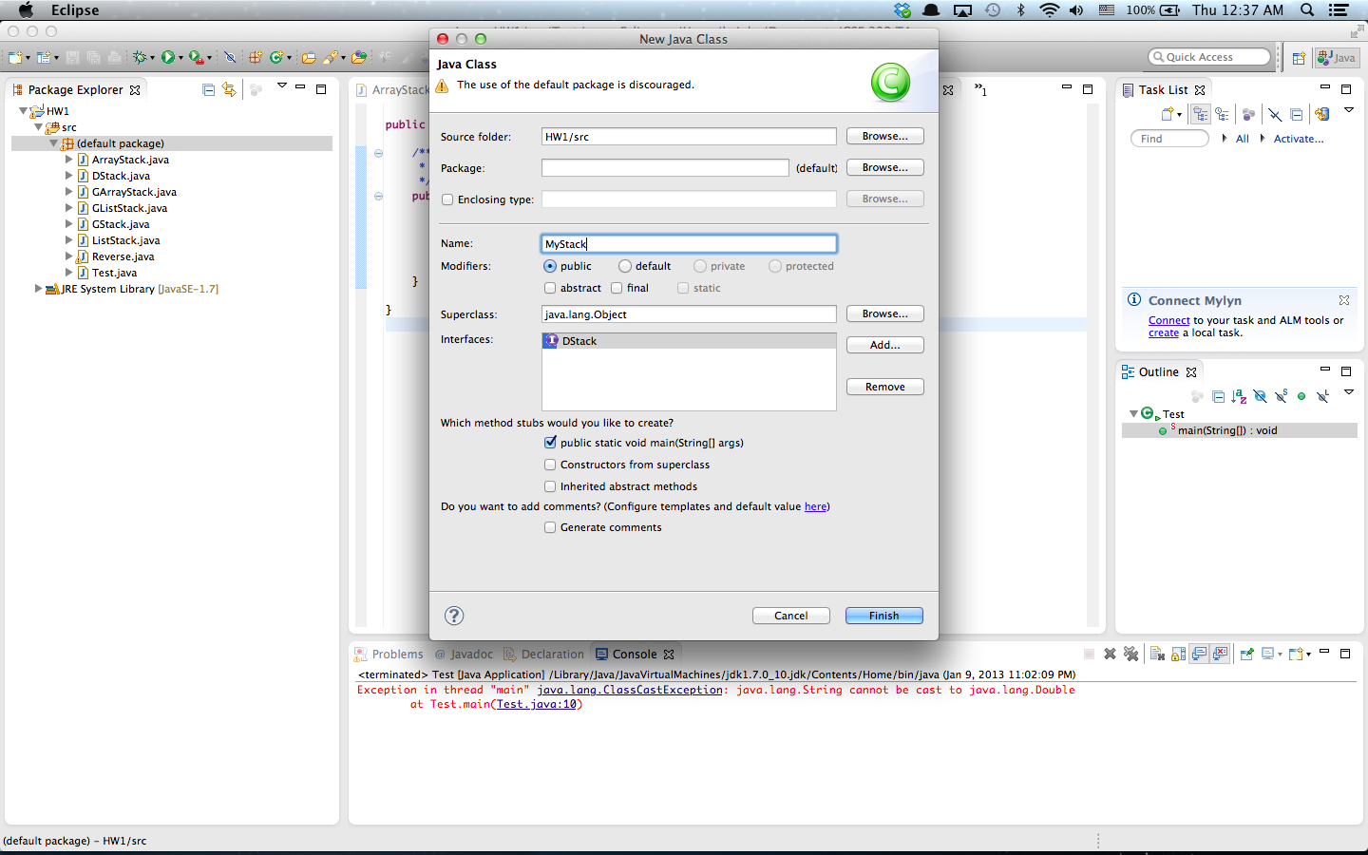
Eclipse Tutorial
Create Class

Slide 18
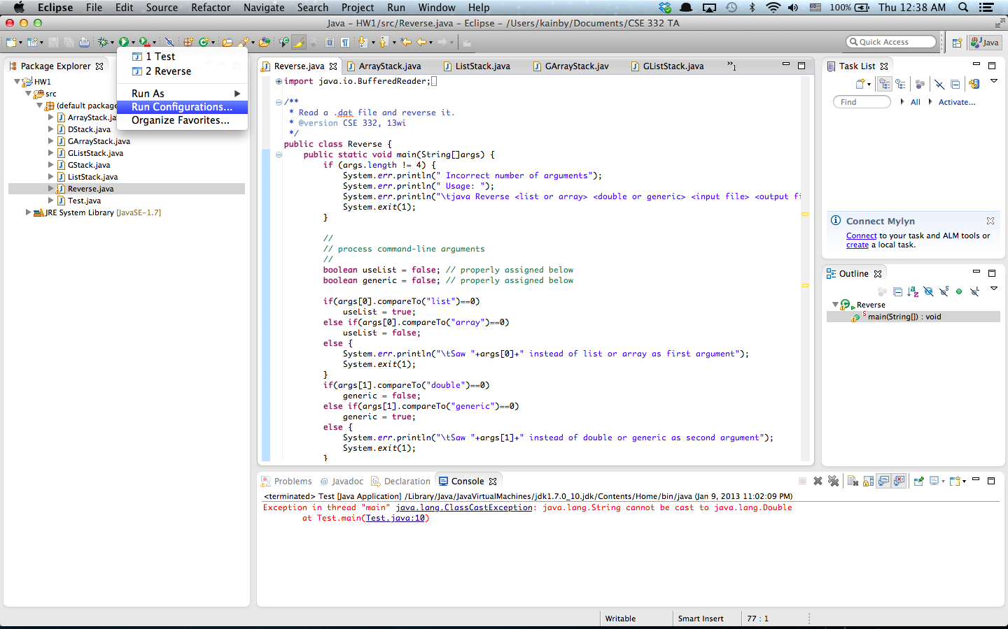
Eclipse Tutorial
Run Configuration (Command line Args)

Slide 19
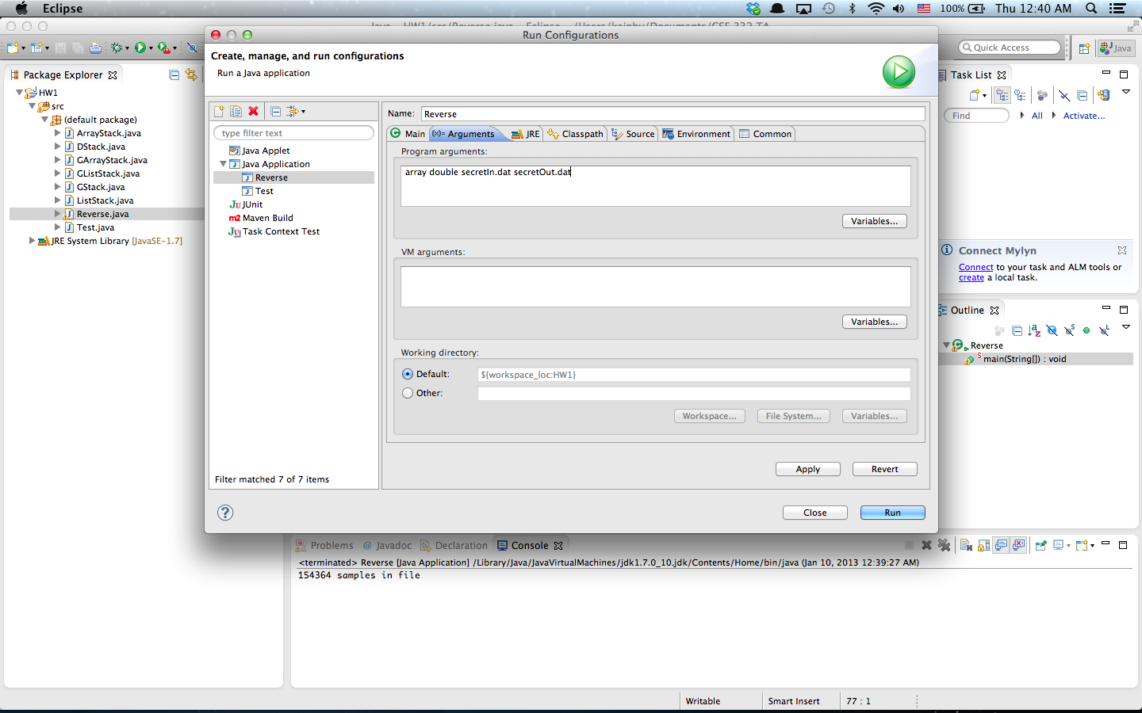
Eclipse Tutorial
Run Configuration (Command line Args)

Slide 20
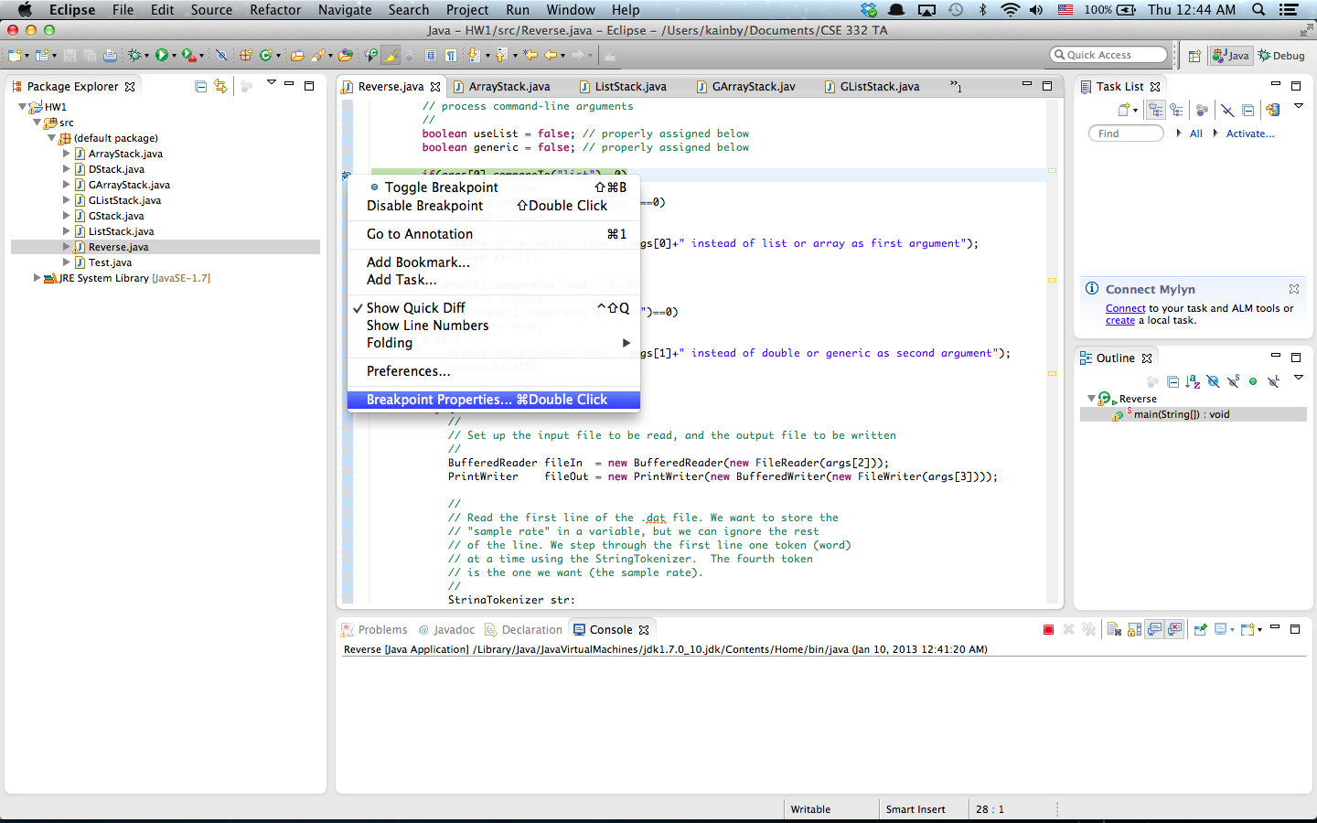
Eclipse Tutorial
Conditional Debugging

Slide 21
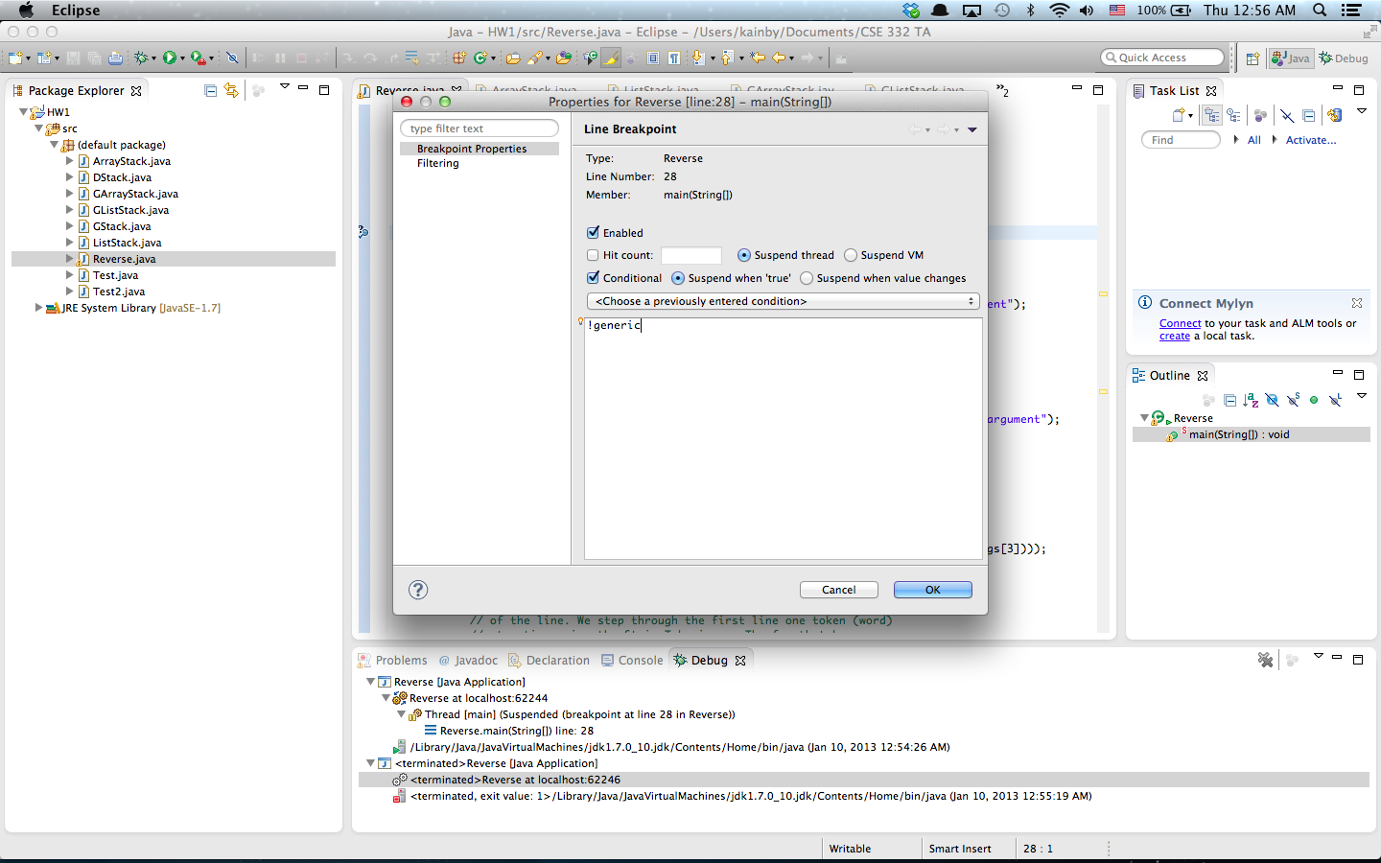
Eclipse Tutorial
Conditional Debugging

Slide 22
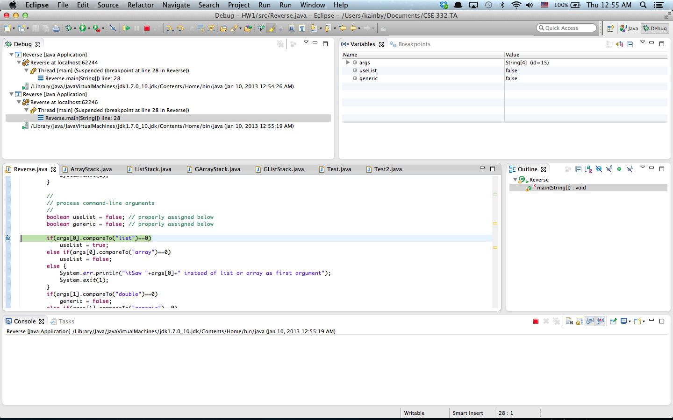
Eclipse Tutorial
Conditional Debugging

Slide 23
Eclipse Tutorial
More Tutorials
- Written Tutorial
http://www.vogella.com/articles/Eclipse/article.html
- Video Tutorial
http://eclipsetutorial.sourceforge.net/totalbeginner.html
- Eclipse Shortkeys
http://www.rossenstoyanchev.org/write/prog/eclipse/eclipse3.html

